Slide 1
Reactive Power Compensation using Vehicle-toGrid enabled Bidirectional Off-Board EV Battery Charger

Slide 2
ABSTRACT
This paper investigates the application of a gridconnected off-board Electric vehicle (EV) battery charger on the reactive power compensation and simultaneously use as a battery charger (grid-to-vehicle (G2V)) and power generator (vehicle-to-grid (V2G)).
The topology of the charger consists of a grid facing front-end AC-DC cascaded H-bridge bidirectional converter, which controls the power flow between the grid and EV battery using a back-end DC-DC bidirectional converter.
The proposed control algorithm follows the active power command for G2V and V2G operation along with reactive power command from the utility grid when requested, by controlling EV current and battery current.

Slide 3
INTRODUCTION
In recent days, electric vehicles (EVs) have got great attention in developed countries because of reduced gasoline usage and greenhouse gas emissions [1].
One of the key factors for the growing penetration of EVs is the increasing installation of Off-board fast-charging stations.
The off-board charger power electronic circuitry can be unidirectional or bidirectional operated [2], [3].
The bidirectional operation stands for transfer of active power in two ways i. e. grid to vehicle (G2V) and vehicle to grid (V2G). The V2G operation is fascinating in the smart grid because of the stored energy of EV batteries [3], [4].
In a conventional power system, the reactive current is supplied by the energy source.
This causes additional losses in the reactance of the long transmission and distribution network, hence reduces the system efficiency.
Further voltage drop at line reactance reduces the voltage quality of the system. Therefore, it is preferred to generate reactive load demand locally.

Slide 4
LITERATURE SURVEY
In [7] the proposed EV charger is designed to provide reactive power compensation to the grid.
However, to achieve uninterruptible reactive power compensation, the DC link voltage is regulated by EV batteries that affect its life.
Moreover, it goes under more charging and discharging cycles that reduce battery life. Further simultaneous operation of the charger in G2V and V2G with reactive power compensation is not discussed.
Similarly, the charger is used to serve the grid with reactive power support. However, using EV batteries to regulate DC link voltage reduces its performance and life. The reactive power compensation operation of EV charger simultaneously with G2V operation is presented in [10], [11].
Whereas, the charger control strategy proposed regulates the DC link by using the EV batteries and reactive power operation with V2G is not discussed.
A multifunctional EV battery charger is proposed in [12] with both reactive power compensation functions. Still, it does not explore the simultaneous operation of the charger in more than one operating mode at a single time.

Slide 5
PROPOSED SYSTEM
In this paper, an efficient control strategy is developed for a bidirectional off-board EV battery charger, for achieving reactive power compensation when requested from the grid.
The proposed charger controller also enables the reactive power compensation simultaneously with the G2V or V2G operating mode of the charger. In this paper, the reactive power compensation mode of the charger is named as vehicle for grid (V4G) operating mode.
Further, the proposed charger topology provides galvanic isolation to make the EV charger highly reliable in practical applications.
The EV charger controller ensures the unity power factor (UPF) during charging.
The proposed charger control algorithm uses an adaptive notch filter (ANF) for grid synchronization by eliminating PLL from the controller.
Hence the controller has improved dynamics and reduced complexity in implementation

Slide 6
SYSTEM CONFIGURATION
The off-board EV battery charging model configuration is depicted in Fig. 1. The developed EV charger is used to validate the reactive power compensation capability of the charger along with the G2V or V2G operating mode of the charger.
The grid facing front-end AC-DC cascaded Hbridge bidirectional converter (CHBDC) is a single excited voltage source converter.
The back-end DC-DC converter (BBDC) is used to charge/ discharge the EV batteries. The detailed circuit configuration of the BBDC is shown in Fig. 1.
The presented configuration can operate in two modes (Buck and boost) by controlling the two switches (S1, S2).
The control of switch S1 operates the BBDC as a buck converter and boost mode can be achieved by controlling S2.
Hence, the charging and discharging of the EV batteries can be achieved by operating the BBDC in buck and boost mode.

Slide 7
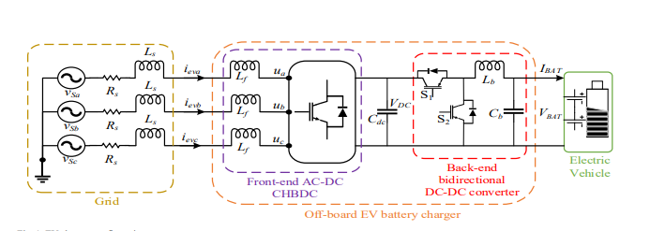
PROPOSED BLOCK DIAGRAM

Slide 8
Cascaded Hbridge bidirectional converter (CHBDC)
The detailed circuit configuration of the grid facing converter is shown in Fig. 2. The presented configuration of the converter contains three H-bridge modules per phase.
Each H-bridge output is connected to the primary side of a single-phase toroidal core transformer. The secondary windings of three transformers are connected in the series, which added up the secondary voltage of each transformer to give per phase output voltage. As presented in Fig. 2, each H-bridge per phase contributes equally i.e. 33.33% of the output phase voltage.
The use of the toroidal core transformer enables the converter to operate with a single DC excitation voltage.
Furthermore, it eliminates the additional use of voltage matching sensors required to maintain equal power distribution among the modules [13].
The added advantages with the presented H-bridge configuration are very low charging current ripples, both current and voltage control capabilities, and provide galvanic isolation [13].
The grid facing CHBDC is coupled to the power grid through the L-filter as shown in Fig. 1 to improve the converter output voltage quality.
Due to the multilevel structure, L-filter is sufficient to eliminate higher-order switching harmonics.

Slide 9
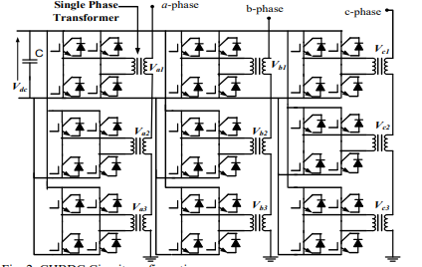
CHBDC Circuit configuration

Slide 10
CONTROL STRATEGY OF THE EV CHARGER
The controller designed in this paper serves two main objectives first, to charge the EV battery by taking active power from the grid (G2V) and send back active power when requested from the grid i. e. V2G operation.
Second, it supplies the reactive power to the grid when requested from the utility grid operator.
The detail controller structure is presented in Fig. 3.
The proposed control algorithm uses ANF to maintain synchronization between the grid and the charger.
The ANF for grid synchronization is first proposed in [14].
The ANF works effectively irrespective of the system disturbances and eliminates conventional PLL from the system controller.

Slide 11
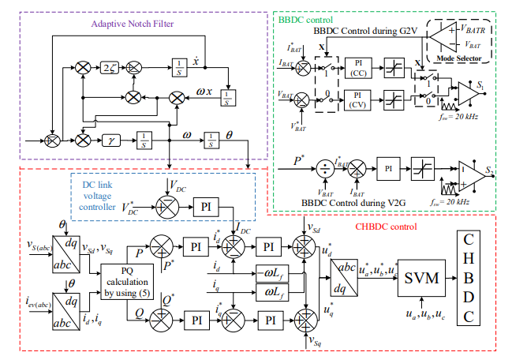
. Bidirectional EV charger controller block diagram

Slide 12
CHBDC CONTROL OPREATION
The three-phase grid voltages and currents are transferred to the dq- frame from abc-frame by using park transformation .
Similarly, the corresponding dq-frame transformation of a three-phase source current can be estimated by using the transformation matrix.
The reference active power (P ∗ ) and reactive power Q∗ ) are compared with the measured active and reactive power and the error signal is passed through a PI controller to estimate reference active current (/! ∗ ) and reactive current (/" ∗ ) as shown in Fig. 3.
The P∗ is the active power command for battery charging or battery power delivery.
Positive P ∗ refers to charging power that the charger has to draw from the grid and the negative sign represents the active power delivered to the grid from the battery.
The Q∗ refers to the amount of reactive power requested by the grid from the charger. Positive Q∗ refers to the inductive reactive power requested by the grid from the charger, hence the charger is drawing reactive power from the grid.
Negative Q∗ refers to capacitive reactive power requested by the grid from the charger, hence the charger supplies reactive power to the grid.

Slide 13

The DC link voltage is added to the active current component for generating the total active current component. After that, the reference active and reactive currents are compared with the measured grid current transferred to the dq-frame .
The inner PI control loop output first summed with the corresponding measured grid voltage in the dq-frame then summed with decoupling terms to generate the reference voltage of CHBDC. The detail calculations are summarized as below:
The inverse park transformation of the charger reference voltage in the dq-frame gives the charger reference voltage in the abc-frame.
The charger reference voltage and the actual charger voltage are fed to the space vector modulation to generate the triggering pulses for CHBDC as shown in Fig. 3.

Slide 14
OPERATIONAL MODES
In this paper, four operating modes of the charger are discussed and validated named as G2V, V2G, G2V with V4G, and V2G with V4G. Furthermore, the charger controller enables both inductive and capacitive reactive power support to the grid in V4G operating mode.

Slide 15
SIMULATION RESULTS
A MATLAB/Simulink model is created to validate the proposed EV battery charger controller performance during the charger's discussed operating modes. The charger first operates in G2V mode, charging the battery with the agreement that it will supply reactive power whenever it is requested from the utility grid. If the grid requests reactive power, the controller can operate with a different charging power.

Slide 16
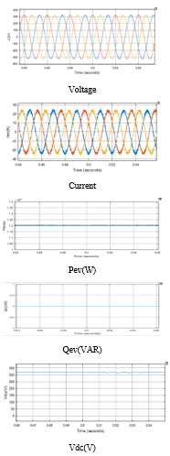
Fig. 5. EV charger performance in G2V operating mode.

Slide 17
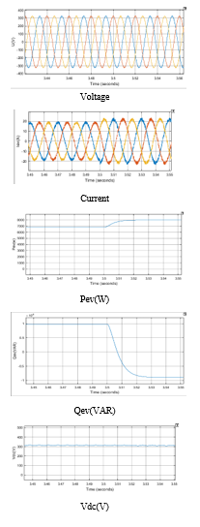
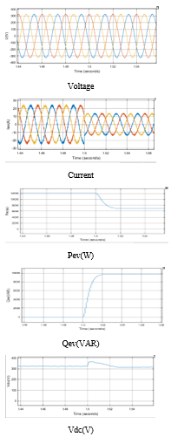
Fig. 6. Transition from G2V operating mode to G2V with V4G (inductive reactive power).

Slide 18
Fig. 7. Transition from G2V with V4G (inductive reactive power) operating mode to G2V with V4G (capacitive reactive power).

Slide 19
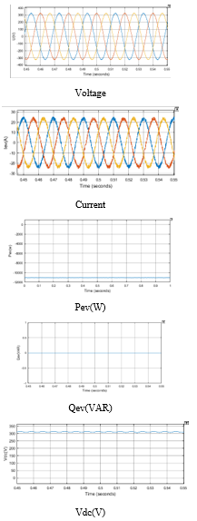
Fig. 8.EV charger performance in V2G operating mode.

Slide 21
CONCLUSION
In this paper, an efficient control strategy is proposed by considering G2V and V2G mode along with reactive power compensation incorporating EVs as an active element that can store, consume, and provide energy. The charger configuration provides galvanic isolation at the user end for safety measures. The developed control algorithm operates satisfactorily in different operating states and the modes of operation are well executed following the power command. The charger has a good steady-state as well as dynamic performance. The off-board charger responds to the power command transition in less than two grid cycles time. The EV battery is not affected during reactive power operation, hence improves battery life. The simulation results validate the proposed controller performance successfully during different power command scenarios. The obtained results show the presented charger is a promising candidate for reactive power support services to be utilized by the utility grid.

Slide 22
REFERENCES
[1] S. S. Williamson, A. K. Rathore and F. Musavi, "Industrial Electronics for Electric Transportation: Current State-of-the-Art and Future Challenges," in IEEE Transactions on Industrial Electronics, vol. 62, no. 5, pp. 3021-3032, May 2015.
[2] A. Kuperman, U. Levy, J. Goren, A. Zafransky, and A. Savernin, “Battery charger for electric vehicle traction battery switch station,”IEEE Trans. Ind. Electron., vol. 60, no. 12, pp. 5391–5399, 2013.
[3] M. Restrepo, J. Morris, M. Kazerani and C. A. Cañizares, "Modeling and Testing of a Bidirectional Smart Charger for Distribution System EV Integration," IEEE Transactions on Smart Grid, vol. 9, no. 1, pp. 152-162, Jan. 2018.
[4] A. Khaligh and S. Dusmez, "Comprehensive Topological Analysis of Conductive and Inductive Charging Solutions for Plug-In Electric Vehicles," IEEE Transactions on Vehicular Technology, vol. 61, no. 8, pp. 3475-3489, Oct. 2012.
[5] S. E. Letendre and W. Kempton, “The V2G concept: a new model for power?” Public Utilities Fortnightly, pp. 16–26, Feb. 2002.

